Slide 1
HY-TTC 500 Family
Product Presentation
Christiana Seethaler
18.09.2014

Slide 2

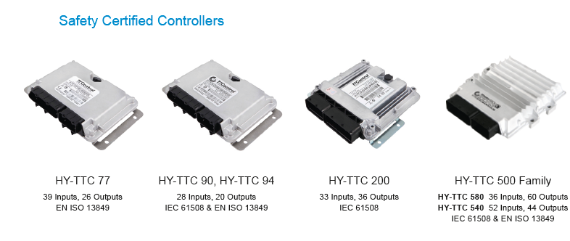
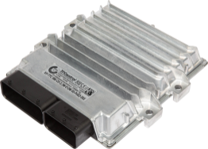
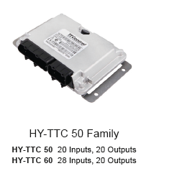

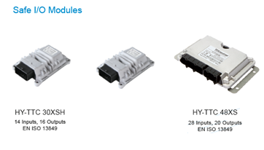
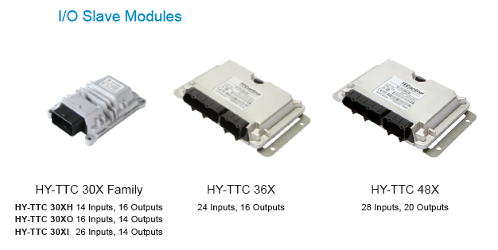
Product Portfolio –
ECUs and I/O Modules
Safety Certified Controllers
General Purpose Controllers
HY-TTC 77
39 Inputs, 26 Outputs
EN ISO 13849
HY-TTC 90, HY-TTC 94
28 Inputs, 20 Outputs
IEC 61508 & EN ISO 13849
HY-TTC 200
33 Inputs, 36 Outputs
EN ISO 13849
HY-TTC 500 Family
HY-TTC 580 36 Inputs, 60 Outputs
HY-TTC 540 52 Inputs, 44 Outputs
IEC 61508 & EN ISO 13849
HY-TTC 50 Family
HY-TTC 50 20 Inputs, 20 Outputs
HY-TTC 60 28 Inputs, 20 Outputs
Safe I/O Modules
I/O Slave Modules
HY-TTC 30XSH
14 Inputs, 16 Outputs
EN ISO 13849
HY-TTC 30XSI
26 Inputs, 4 Outputs
EN ISO 13849
HY-TTC 48XS
28 Inputs, 20 Outputs
EN ISO 13849
HY-TTC 30X Family
HY-TTC 30XH 14 Inputs, 16 Outputs
HY-TTC 30XO 16 Inputs, 14 Outputs
HY-TTC 30XI 26 Inputs, 4 Outputs
HY-TTC 36X
26 Inputs, 16 Outputs
HY-TTC 48X
28 Inputs, 20 Outputs
26 Inputs, 16 Outputs

Slide 3
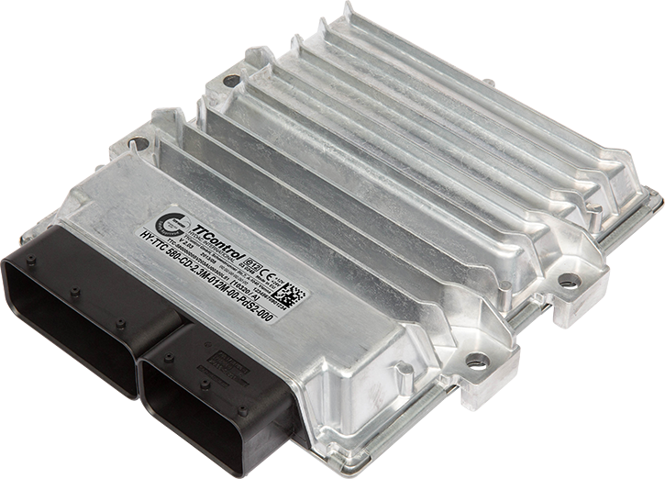
HY-TTC 500 Family
HY-TTC 580
36 Inputs, 60 Outputs
IEC 61508 SIL 2
ISO 13849 PL d
HY-TTC 540
52 Inputs, 44 Outputs
IEC 61508 SIL 2
ISO 13849 PL d

Slide 4
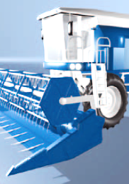
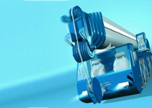
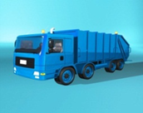
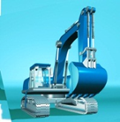
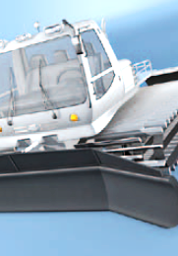


Target Applications
Large construction /
material handling machines
Large municipal vehicles
Large agricultural machines
Drilling rigs, crawler cranes, mobile cranes, concrete pumps, rollers, compactors, asphalt pavers, fire trucks, garbage collecting, forage harvesters, potato harvesters etc.

Slide 5
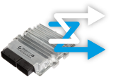



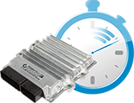
Highlights and Benefits
Overview
Flexibility and Usability
Safety & Availability
96 I/Os with multiple
configuration options
Open programming environments
C, CODESYS Safety SIL 2 and
CODESYS Standard
EN ISO 13849 PL d &
IEC 61508 SIL 2 TÜV certified
ISO 25119 AgPL d certifiable
CODESYS Safety SIL 2 including support for CANopen Safety Master and separation of safe / non-safe code
CODESYS „standard“ for applications without safety requirements
Output shut-off in groups
Connectivity
Up to 7 CAN interfaces
Automatic baudrate detection
Configurable CAN
termination
Ethernet
Robustness
Performance
Automotive style aluminium housing
for rough operating conditions
Total current up to 60A
32-bit 180MHz dual-core lockstep
Floating-Point-Unit
Up to 2.3MB RAM / 11 MB Flash

Slide 6
Highlights and Benefits
Overview
Flexibility and Usability
Safety & Availability
96 I/Os with multiple
configuration options
Open programming environments
C, CODESYS Safety SIL 2 and
CODESYS Standard
EN ISO 13849 PL d &
IEC 61508 SIL 2 TÜV certified
ISO 25119 AgPL d certifiable
CODESYS Safety SIL 2 including support for CANopen Safety Master and separation of safe / non-safe code
CODESYS „standard“ for applications without safety requirements
Output shut-off in groups
Connectivity
Up to 7 CAN interfaces
Automatic baudrate detection
Configurable CAN
termination
Ethernet
Robustness
Performance
Automotive style aluminium housing
for rough operating conditions
Total current up to 60A
32-bit 180MHz dual-core lockstep
Floating-Point-Unit
Up to 2.3MB RAM / 11 MB Flash

Slide 7

Flexibility and Usability
Open programming environments
    C-programming
    CODESYS Safety SIL 2*
    CODESYS Standard (non-Safety)
96 I/O pins with multiple software configuration options per pin
* CODESYS® Safety SIL 2 including support for CANopen® Safety Master

Slide 8
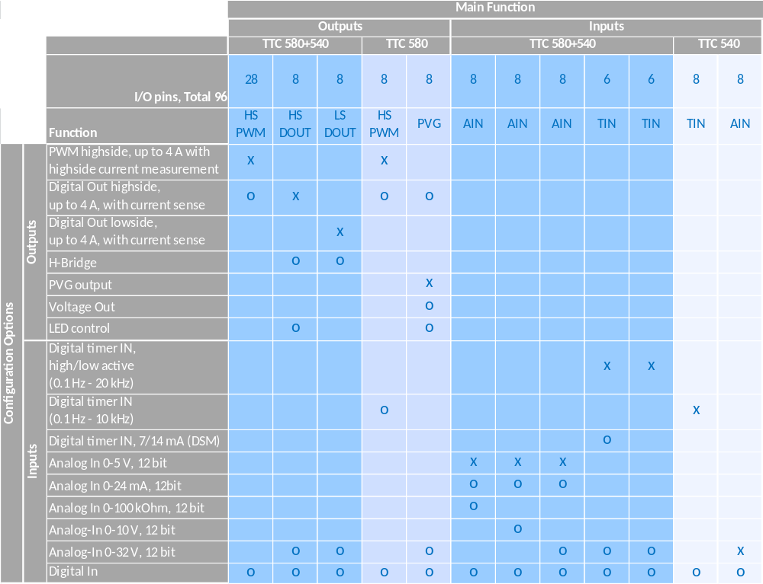
I/O Flexibility
X – Main function
O – Configuration option

Slide 9
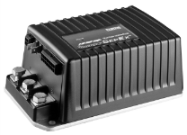
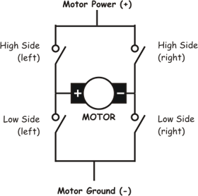
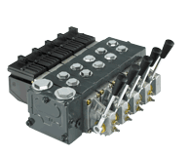


Flexibility and Usability
- new features
Voltage Out (8x)
Use Case:
  Electrical motor controller input
  Use as VCU (vehicle control unit)
H-Bridge
    combining 2xHS and 2xLS Digital outputs
    (or 4+4 or 8+8 for higher currents)
    Use Case:
    Motor control
    (forward/reverse)
PVG Out (8x)
    Control of Danfoss PVG32 Valves
    Use case:
    Migration path from Danfoss valves to PWM-controlled valves
Real-Time-Clock (RTC)
Real-time clock with external battery
Use Case:
Safe date&time for error log entries
Wake-Up
    Wake-Up pin in addition to K15 (ignition key): e.g. via door switch
    Use Case:
    pre-boot sequence
    (safe seconds for bootup time)

Slide 10
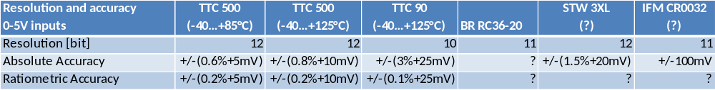
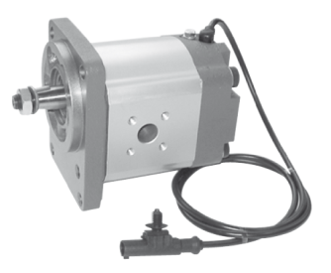
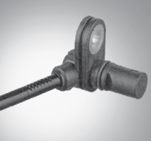
Flexibility and Usability
- differentiation from competition
12-bit-ADCs with highest accuracy
Advantage:
more flexibility in choosing sensors
DSM sensors
Bosch-Rexroth rotary speed sensors with 7/14mA levels, stand-still recognition,..
Used in (Rexroth) pumps, gearboxes, axial piston motors, fan drives,..
Not available on STW or IFM ECUs.
Sensor gives out current signal 7/14mA
(normal sensors give a voltage signal)

Slide 11
Highlights and Benefits
Overview
Flexibility and Usability
Safety & Availability
96 I/Os with multiple
configuration options
Open programming environments
C, CODESYS Safety SIL 2 and
CODESYS Standard
EN ISO 13849 PL d &
IEC 61508 SIL 2 TÜV certified
ISO 25119 AgPL d certifiable
CODESYS Safety SIL 2 including support for CANopen Safety Master and separation of safe / non-safe code
CODESYS „standard“ for applications without safety requirements
Output shut-off in groups
Connectivity
Up to 7 CAN interfaces
Automatic baudrate detection
Configurable CAN
termination
Ethernet
Robustness
Performance
Automotive style aluminium housing
for rough operating conditions
Total current up to 60A
32-bit 180MHz dual-core lockstep
Floating-Point-Unit
Up to 2.3MB RAM / 11 MB Flash

Slide 12
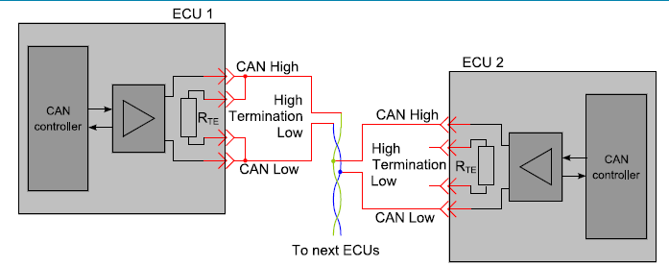
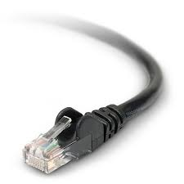
Connectivity
Up to 7 CAN interfaces for maximum data throughput and individual network architectures (higher robustness)
Automatic CAN baud rate detection
Configurable termination for up to 3 CAN interfaces
Ethernet for download and debugging purpose
significantly speeds up development and commissioning

Slide 13
Highlights and Benefits
Overview
Flexibility and Usability
Safety & Availability
96 I/Os with multiple
configuration options
Open programming environments
C, CODESYS Safety SIL 2 and
CODESYS Standard
EN ISO 13849 PL d &
IEC 61508 SIL 2 TÜV certified
ISO 25119 AgPL d certifiable
CODESYS Safety SIL 2 including support for CANopen Safety Master and separation of safe / non-safe code
CODESYS „standard“ for applications without safety requirements
Output shut-off in groups
Connectivity
Up to 7 CAN interfaces
Automatic baudrate detection
Configurable CAN
termination
Ethernet
Robustness
Performance
Automotive style aluminium housing
for rough operating conditions
Total current up to 60A
32-bit 180MHz dual-core lockstep
Floating-Point-Unit
Up to 2.3MB RAM / 11 MB Flash

Slide 14
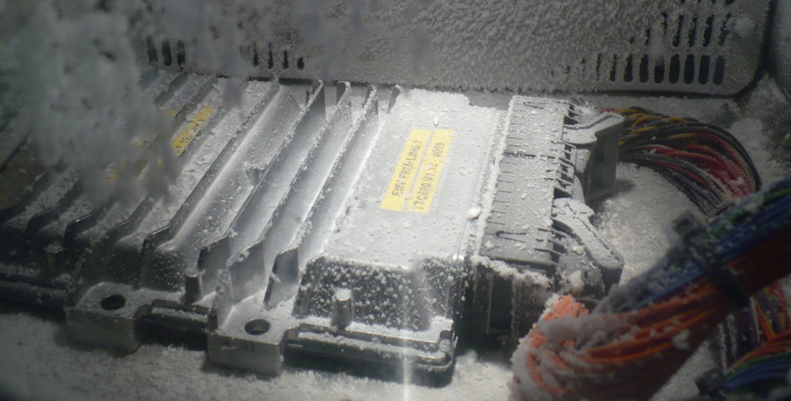
Robustness
Automotive style aluminum diecast housing suited for rough operating conditions
Total current up to 60A over whole temperature range
(-40..+85°C)
All components rated -40°..+125°C

Slide 15
Highlights and Benefits
Overview
Flexibility and Usability
Safety & Availability
96 I/Os with multiple
configuration options
Open programming environments
C, CODESYS Safety SIL 2 and
CODESYS Standard
EN ISO 13849 PL d &
IEC 61508 SIL 2 TÜV certified
ISO 25119 AgPL d certifiable
CODESYS Safety SIL 2 including support for CANopen Safety Master and separation of safe / non-safe code
CODESYS „standard“ for applications without safety requirements
Output shut-off in groups
Connectivity
Up to 7 CAN interfaces
Automatic baudrate detection
Configurable CAN
termination
Ethernet
Robustness
Performance
Automotive style aluminium housing
for rough operating conditions
Total current up to 60A
32-bit 180MHz dual-core lockstep
Floating-Point-Unit
Up to 2.3MB RAM / 11 MB Flash

Slide 16

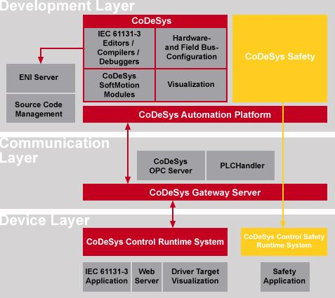
Safety
TÜV certified
according to IEC 61508 SIL 2, ISO 13849 PL d
Certifiable to ISO 25119 AgPL d
Hardware metrics (MTTFd / DC and PFH/SFF) available for the customer – total value and value per I/O
CODESYS Safety SIL 2
TÜV certified run-time-system
Separation of safe/non-safe code
CANopen Safety master functionality
Safety + availablility
Output shut-off in up to 3 groups guarantees high availability
Complete shut-off not necessary in case of single I/O failure

Slide 17

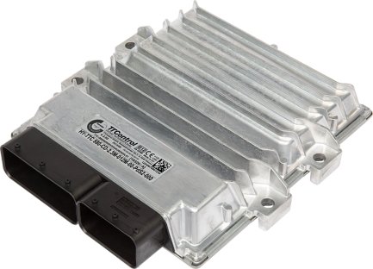
Production Quality &
Product Availability
Production Parnter Continental ensures
Production quality according to automotive standards for high volumes
Electronic components are used out of database of qualified components whenever feasible; high quality and availability guaranteed
Second source components for majority of components, guarantees high product availability in case of component shortage or component obsolescence

Slide 18
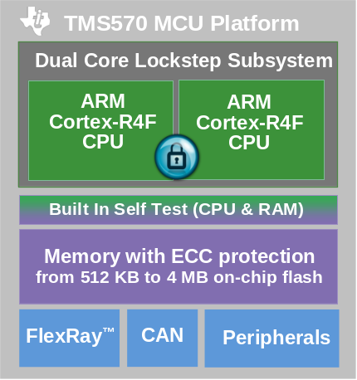
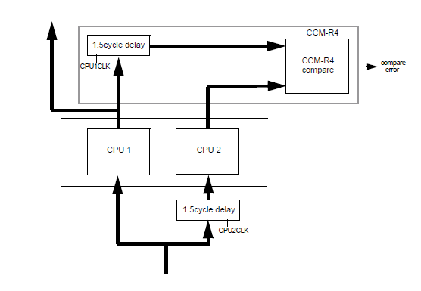
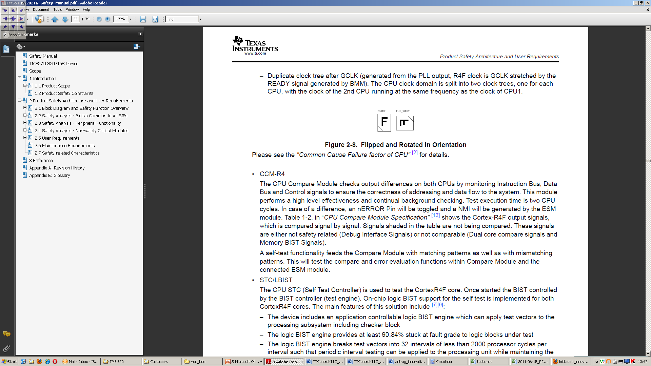
Safety
CPU dedicated for safety applications
TMS570 Dual Core lockstep CPU
    Plus Safety Companion
    Designed for applications up to
    ASIL D / SIL 3
Two ARM Cores with 1.5 cycle delay
Outputs of both CPUs are compared
Several measures to avoid Common Cause Failures
Cores 100um separated with power ring
One core flipped and rotated in orientation

Slide 19
Highlights and Benefits
Overview
Flexibility and Usability
Safety & Availability
96 I/Os with multiple
configuration options
Open programming environments
C, CODESYS Safety SIL 2 and
CODESYS Standard
EN ISO 13849 PL d &
IEC 61508 SIL 2 TÜV certified
ISO 25119 AgPL d certifiable
CODESYS Safety SIL 2 including support for CANopen Safety Master and separation of safe / non-safe code
CODESYS „standard“ for applications without safety requirements
Output shut-off in groups
Connectivity
Up to 7 CAN interfaces
Automatic baudrate detection
Configurable CAN
termination
Ethernet
Robustness
Performance
Automotive style aluminium housing
for rough operating conditions
Total current up to 60A
32-bit 180MHz dual-core lockstep
Floating-Point Unit
Up to 2.3MB RAM / 11 MB Flash

Slide 20
Performance
CPU core and memory
32-bit / 180 MHz TI TMS 570 dual core lockstep processor (ARM Architecture)
Safety Companion
Floating-Point-Unit
Up to 11MB Flash, 2.3MB RAM
Safety mechanisms in hardware to minimize CPU load
Use case for large flash memory: data logging in case of machine breakdown or accident

Slide 21
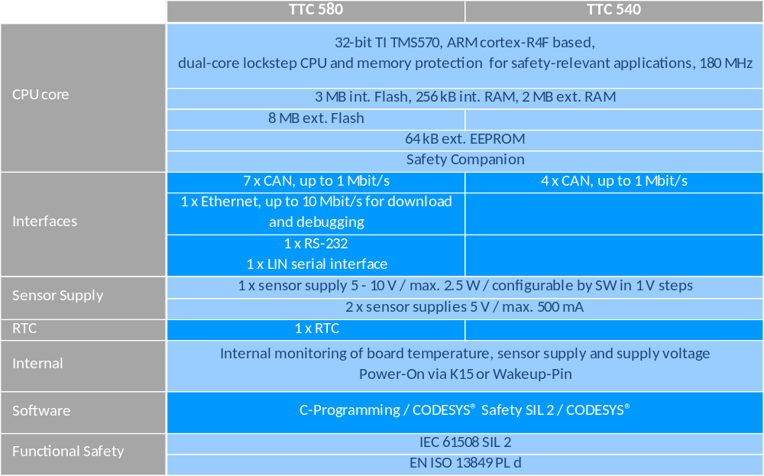
HY-TTC 500 Family

Slide 22
Offering
ECUs
10320 – HY-TTC 580 CODESYS (Series)
10321 – HY-TTC 580 C-Programming (Series)
10465 – HY-TTC 580 C-Programming DEVEL (Series)
10318 – HY-TTC 540 CODESYS (Series)
10319 – HY-TTC 540 C-Programming (Series)
10480 – HY-TTC 540 C-Programming DEVEL (Series)
Accessories
10378 – HY-TTC 500 Cable Harness with open ends, 3m
10386 – HY-TTC 500 Interface Board KIT (including cable harness 1,5m)
10391 – HY-TTC 500 JTAG-Adapter
10439 – Connector kit (58 pole) for HY-TTC 500 Family
10440 – Connector kit (96 pole) for HY-TTC 500 Family

Slide 23
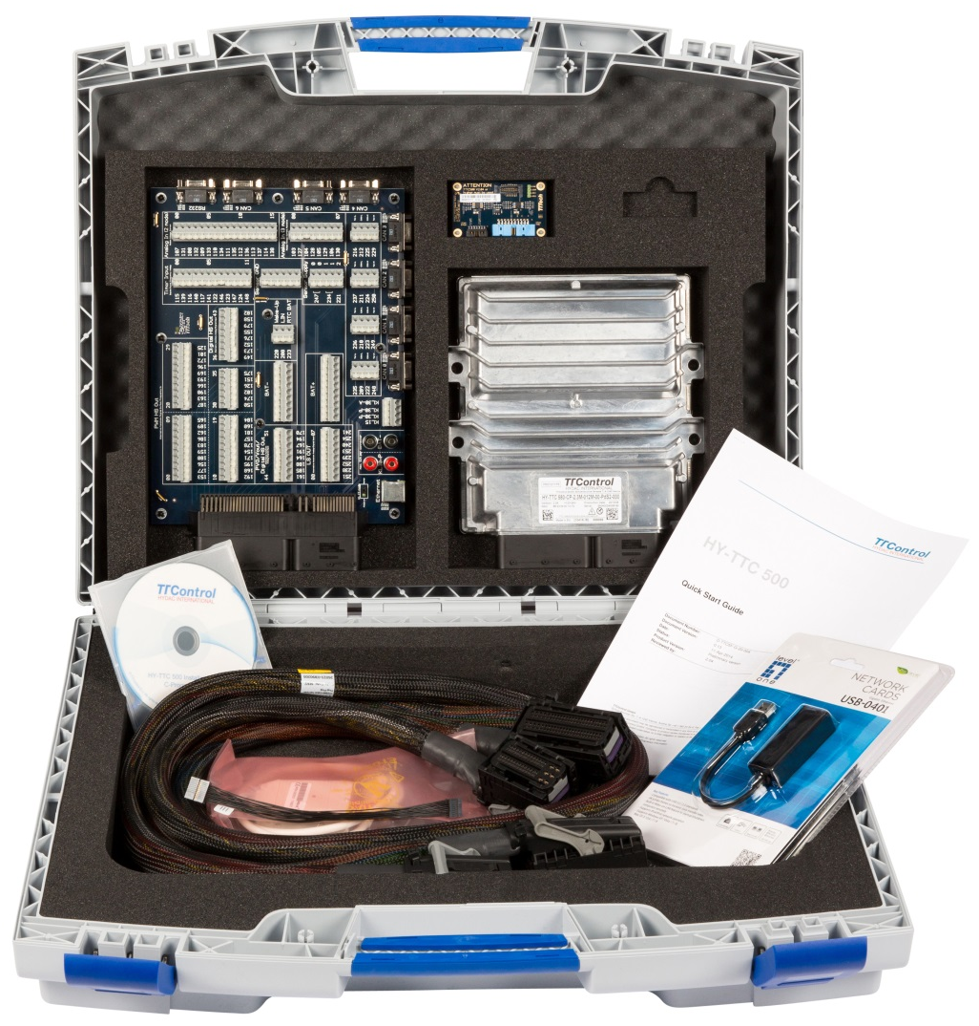
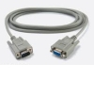
Offering
Development Kits for C-Programming
10432 – HY-TTC 580 Development Kit for C-Programming
  1 x HY-TTC 580 ECU OPEN housing
  for C-programming (A)
  1 x HY-TTC 500 JTAG-Adapter (B)
  1 x HY-TTC 500 JTAG-Adapter Cable (C)
  1 x HY-TTC 500 family Interface Board KIT
  (including cable harness 1,5m) (D)
  1 x Installation CD C-Programming (E)
  1 x Ethernet USB Adapter with driver and software (F)
  1 x PCAN USB Adapter with driver and software (G)
  1 x HY-TTC Datacable 2m (H)
  1 x HY-TTC 500 Quick Start Guide (I)
10473 – HY-TTC 540 Development Kit
D
B
A
I
E
F
H
C
G

Slide 24
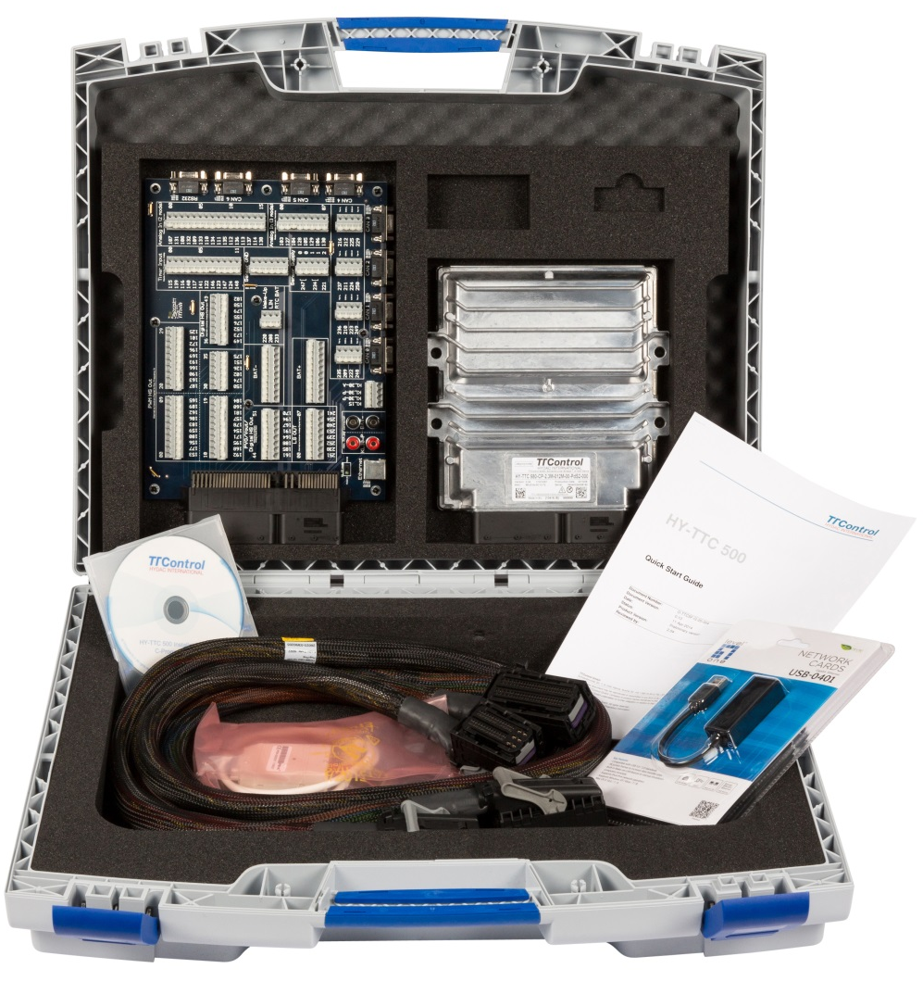
Offering
Development Kits for CODESYS
10434 – HY-TTC 580 Development Kit for CODESYS
  1 x HY-TTC 580 ECU CODESYS (A)
  1 x HY-TTC 500 family Interface Board KIT
  (including cable harness 1,5m) (B)
  1 x Installation CD CODESYS (C)
  1 x Ethernet USB Adapter with driver and software (D)
  1 x PCAN USB Adapter with driver and software (E)
  1 x HY-TTC Datacable 2m (F)
  1 x HY-TTC 500 Quick Start Guide (G)
  10481 – HY-TTC 540 Development Kit
B
A
G
F
C
D
E

Slide 25
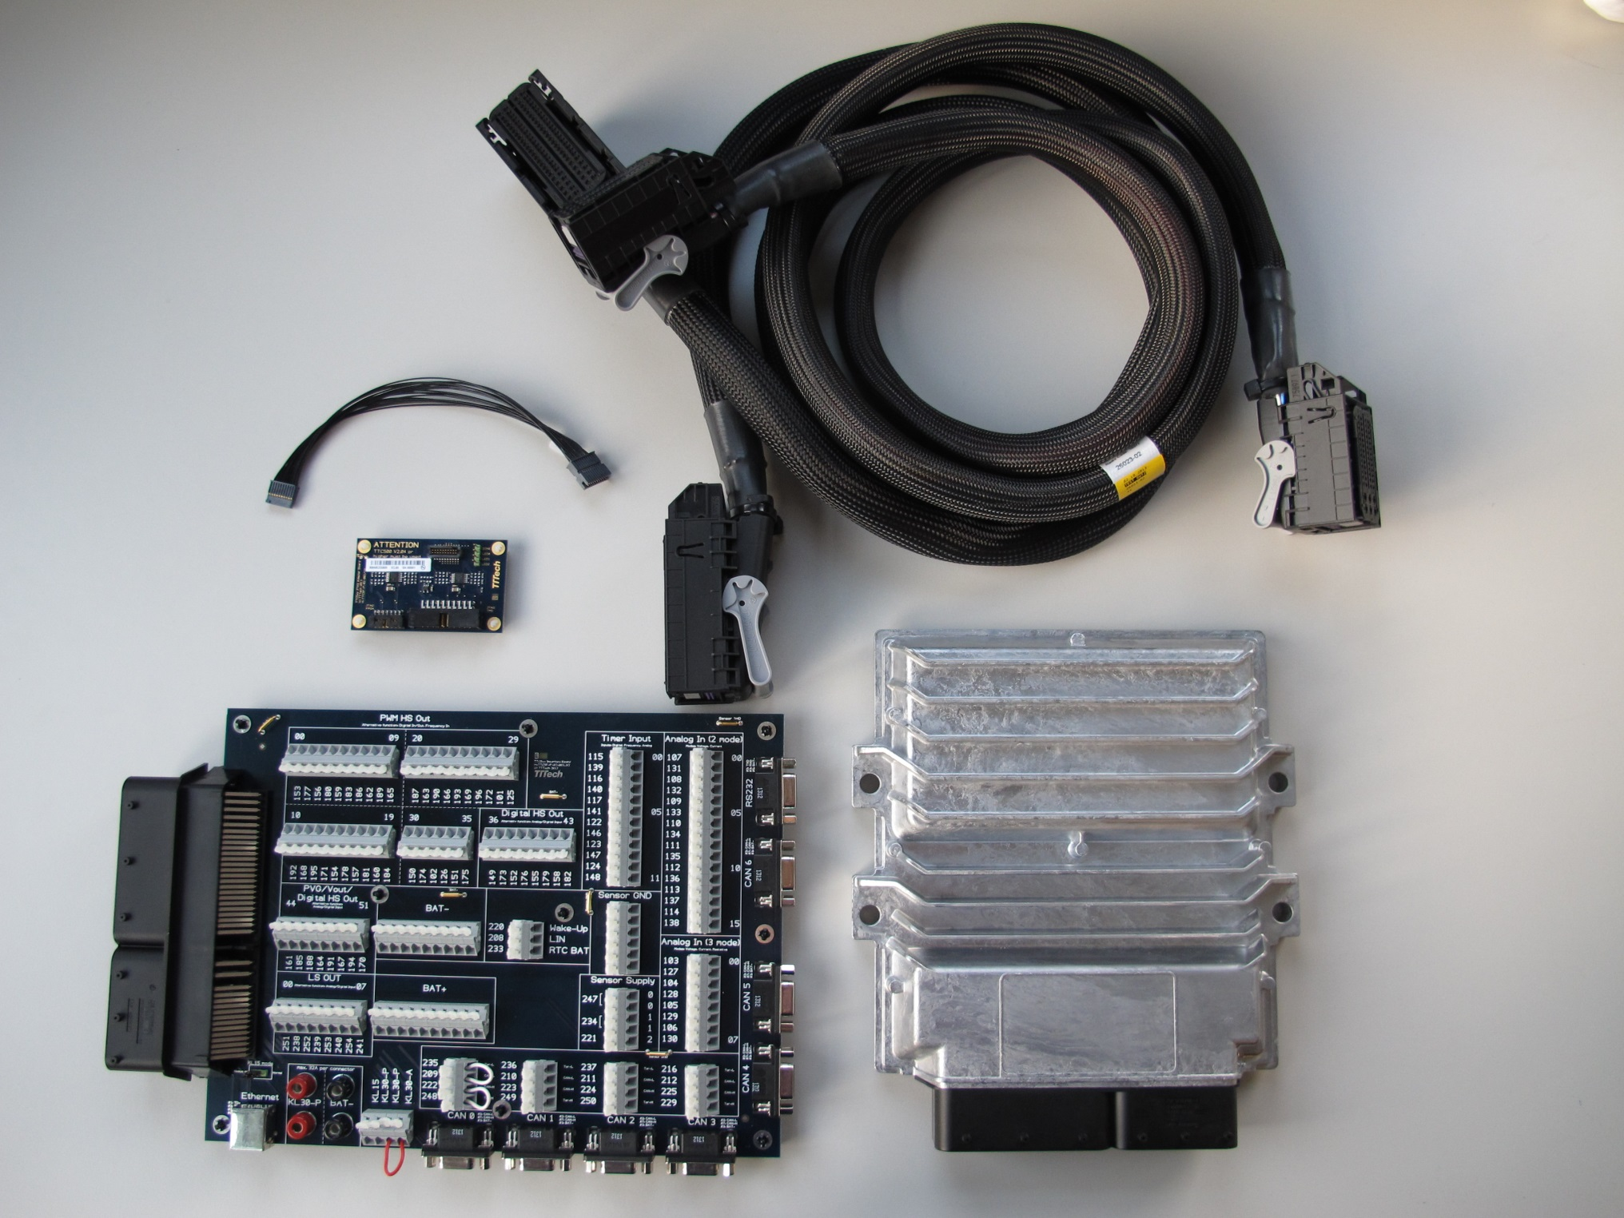
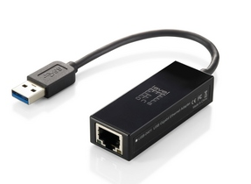
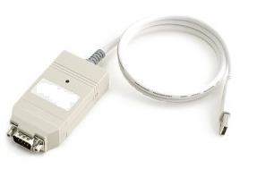
Offering
Development Kits
10432 – HY-TTC 580 Development Kit for C-Programming (B-Sample)
1 x HY-TTC 580 ECU OPEN housing for C-programming (B-Sample)
1 x JTAG-Adapter for HY-TTC 500 family
1 x HY-TTC 500 family Interface Board KIT (including cable harness 1,5m)
1 x Installation CD
1 x PCAN USB Adapter with driver and software
10434 – HY-TTC 580 Development Kit for CODESYS (B-Sample)
      1 x HY-TTC 580 ECU CODESYS (B-Sample)
      1 x HY-TTC 500 family Interface Board KIT (including cable harness 1,5m)
      1 x Installation CD
      1 x PCAN USB Adapter with driver and software

